Slide 1
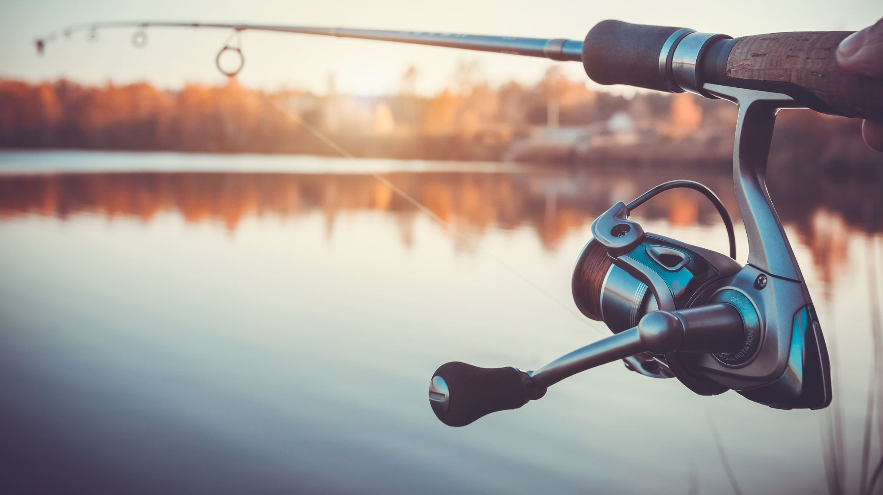
Fishing_Trip V2.py
Created By: Brandon Barrett
Aka
Eomkid or Eomchy

Slide 2
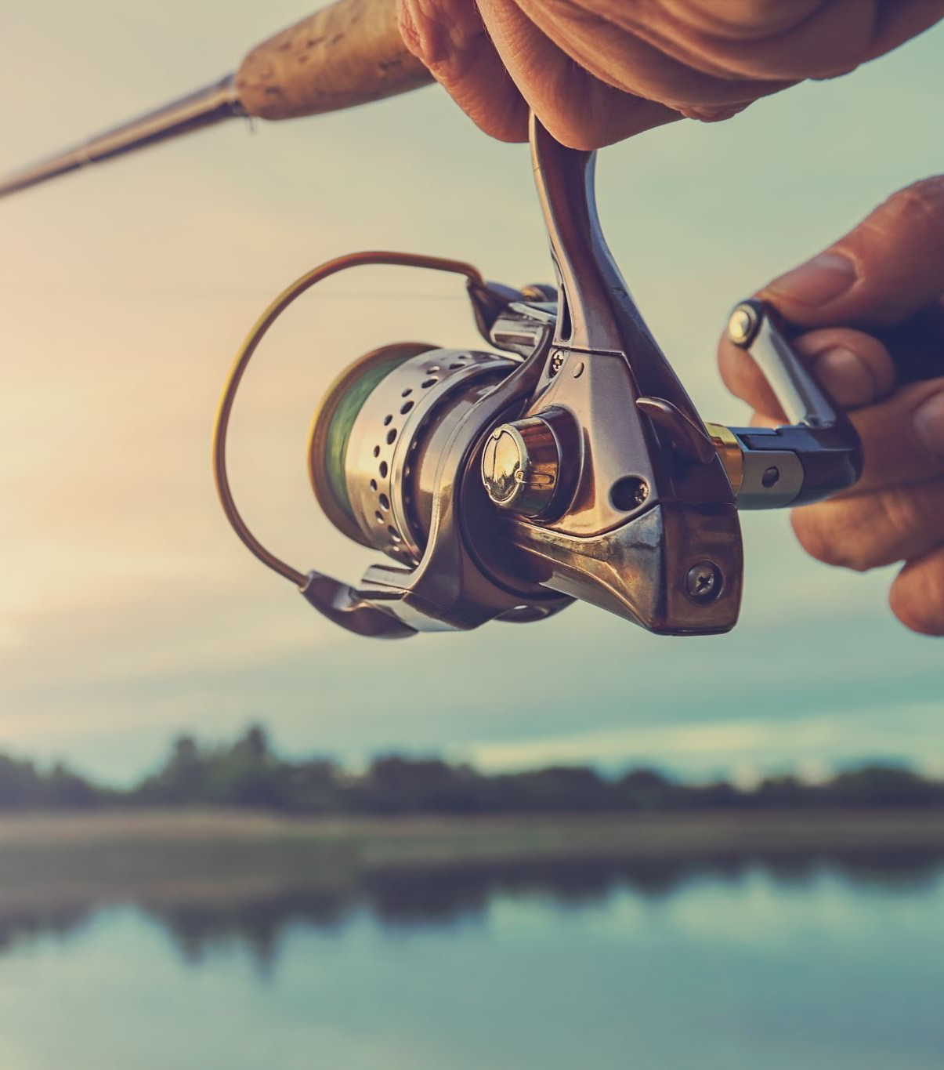
Fishing Trip
This is version 2 of my program called Fishing Trip, the game premise remains the same it is about fishing, catch and selling what you have caught and using you’re the bait you buy to better the game.

Slide 3
Successes in the project
As this is version 2 of the project I had the pre-existing code to work off of this lead to most of the work being simple turning conditionals into useable functions inside their respective modules.
The game was split up into basically 3 parts the fishing system (fish), the player (player) and the main menu (menu) this allowed for much easier management of especially of stored values like money and fish caught.

Slide 4
Places of improvement
Firstly, I struggled with the creation of tests as it was my first time working with them. I had to do a lot of research to figure out how to create responsible test. And while they pass it I also struggled to figure out of what should and shouldn’t be tested as in the case of something like user input it isn’t worth test and is better to just check input on the fly rather than with a multitude of tests.
Initially I struggled with sorting out things in to their respective modules, as something like deciding if a fish is caught makes sense to be decided by a fish object or a fishing system. In another case I faced the issue of wanting to have another module sell fish but, the fishing module is where said data is storing making it easier to sell from within that module and move it out to where it is needed.

Slide 5
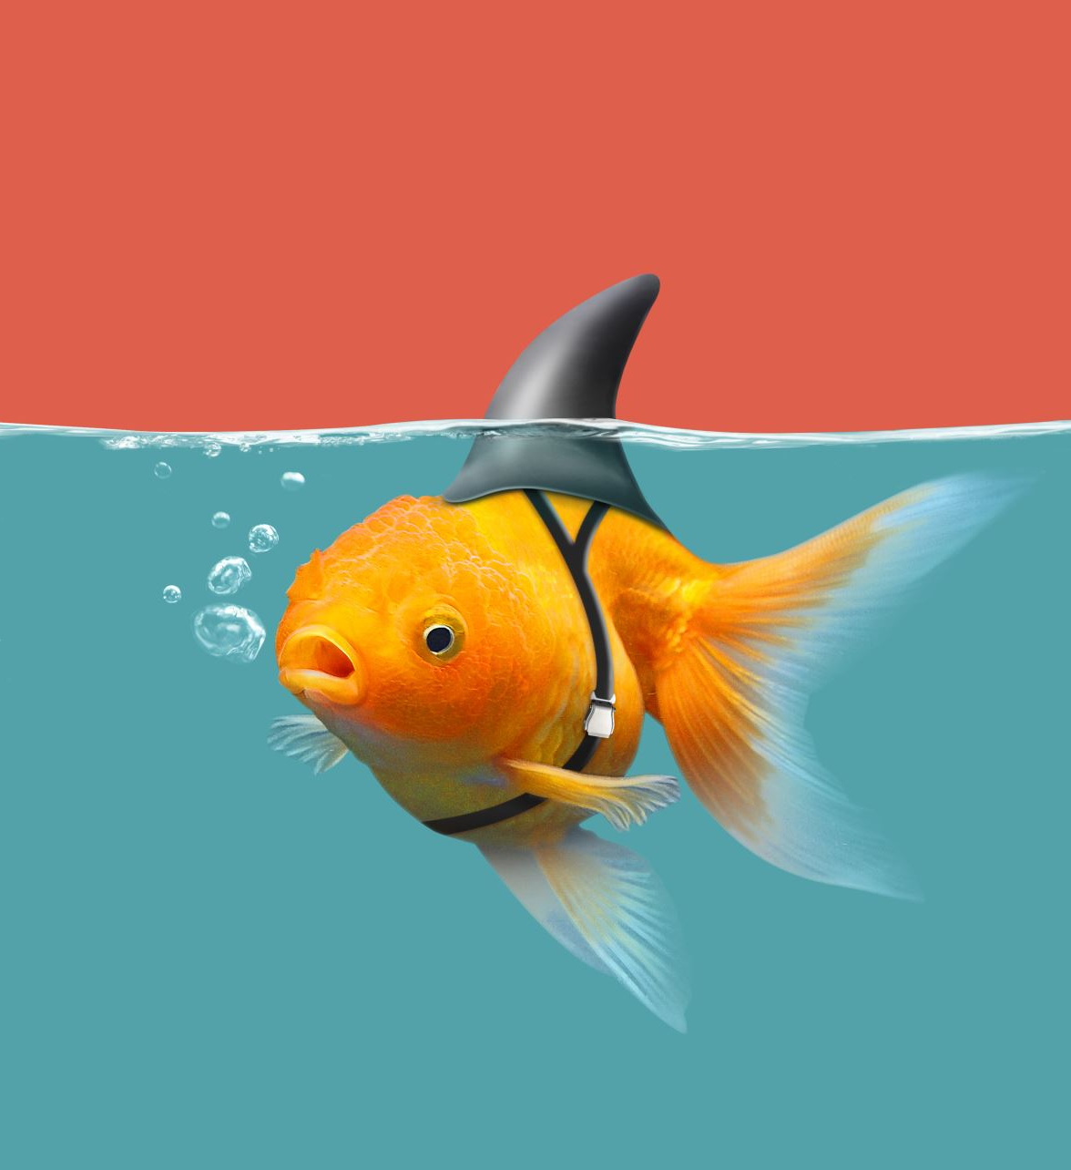
Things Change
This change was primarily taken because I had forgotten to take that requirement of the project into account that being file I/O handling. Then I integrated a simple save simple that writing to a json file allow the game to be picked up, after it has been closed fish still perfect intact and hopefully alive inside your bag.

Slide 6

To my Future self
For my future self I would say that I should plan out modules before I started working on them, as a lot of what I faced was creating a module, then having to go to create an entirely different one because the functionality need for it to work as I was doesn’t exist yet. This was primarily the case when I started I created the player class as that was the most obvious to me with my initial code, I had the player variables at the top. Then I realize it cant do anything with a fish to catch, and manipulate it.

